Slide 1

Intermediate Modeling and Steady-State Statistical Analysis
Chapter 6

Slide 2
What We’ll Do ...
Model 6-1: Electronic assembly/test system from Chapter 4
  Modify with Stations, Transfers, Routes, animation of entity movement
Model 6-2: A small manufacturing system
  Entity-dependent Sequences
  Data requirements and availability
  Verification (debugging)
Statistical analysis of steady-state simulations
  Warmup and run length
  Truncated replications
  Batching
  Other methods and goals

Slide 3

Model 6-1: The Electronic Assembly and Test System with Part Transfers
Generalize earlier model – all part transfers now take 2 minutes (not instant) … want to animate
  Includes arriving parts to prep areas, departing parts to the appropriate exit, and all internal part transfers
Need new concepts
  Stations – location where some process occurs
    Arrivals, manufacturing cells, departures
    Each Station given a unique name
    Entry points for sections of model logic
    Station markers represent stations in the flowchart/animation
  Station Transfers –send entities between Stations without direct connection
    Several different types – we’ll use Routes here, which allow for positive transfer time, but no other delays like “room” or transporters
    Route paths represent Routes in the flowchart/animation

Slide 4
Adding the Route Logic – From Arrival
Stations and Station Transfers affect both the model logic and the animation
Start with Model 4-3 … change to Model 6-1
For incoming parts (A and B) delete connection from Assign modules to “Prep” Process modules
  Replace with Station/Route module pairs
    Station module (Advanced Transfer panel) – define entity’s current location
      Module Name vs. Station Name
    Route module (Advanced Transfer panel) – send entity out
      Route Time, Destination Station
  No direct connections exiting from the Route modules – Route module’s Destination Station defines that

Slide 5
Adding the Remaining Route Logic
Add Station modules for entry to each Prep area
  Station names are Prep A Station, Prep B Station, and are the destination stations for Routes after arrivals
Process modules for Prep A, Prep B unchanged
After prep, entities connected to Route module to send to next station (sealer)
Similar changes for the rest of the model
  Station modules for incoming parts into sealer, rework, each of three Record modules (entity exit points)
  Route modules for outgoing parts out of sealer inspection, rework inspection (two for each Decide module – pass/fail)
Could run model now, get correct results … but no animation of transfers …

Slide 6
Altering the Animation – Station Markers, Routes
Add animation for Stations and Routes
Station button , Animate Transfer toolbar
  Attach Identifier to it from pull-down list of station names
  Get cross hairs, place (click) marker in animation
  Can place several station markers for the same logical station (to represent incoming, outgoing sides)
  Can drag station markers around later
Route button from Animate Transfer toolbar
  Options for appearance of entities as they travel the route
  Get cross hairs; click in origin, destination Station Markers
    Intermediate clicks for corners along the route
  Can drag around endpoints, corners later

Slide 7
Altering the Animation – Entity Pictures
Part B arrivals are in batches of four parts/batch
  But constant travel time to Prep B implies they travel “on top of each other” so it looks like just one part B
  Try – change Route time from 2 to EXPO(2), see separation along the route
Create illusion to animate the batch
  Assign module just after Part B Arrive
  Add assignment of Entity Picture to Picture.Batch B
  Edit/Entity Pictures to draw the new picture
    Copy Picture.Part B and rename it Picture.Batch B
    Double-click on picture, Picture Editor to get four circles
  When batch arrives to Prep B change to single circle (4)
    Add Assign module after Prep B Arrival Station

Slide 8
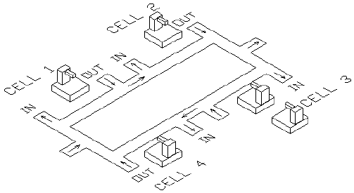
Model 6-2:
A Small Manufacturing System
Part arrivals, four cells, part departures
Cells 1, 2, and 4: single machine each
Cell 3: two machines — newer one 20% faster
  Need: way to model non-identical resource units
Circular layout of cells
Parts enter at left, exit at right, travel only clockwise, all transfer times = 2 min. (realistic?)

Slide 9
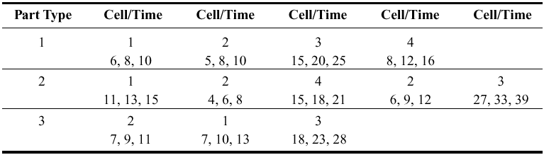
A Small Manufacturing System (cont’d.)
Three separate part types
  Interarrivals (all types merged) ~ expo(13) minutes
  26% type 1, 48% type 2, 26% type 3
Different part types follow different routes, have different (triangular) processing times:
Observe utilizations, time/number in queues, cycle times (times in system) by part type
Run for 32 hours
Parameters are for the slow machine at Cell 3.

Slide 10
New Arena Concepts
Non-identical machines at Cell 3
Different entity types follow different process plans
  Previous models – all entities went through same sequence of stations, maybe with Decides for branching
  Now, need process plan with automatic routing by entity type – different Sequence assigned to each entity (like an attribute), and entity follows its own sequence
  Won’t use direct Connect or Routes … instead we tell entities departing from modules to follow their own Sequence
  Arena internally keeps track of where entity is, where it will go next

Slide 11
The Modeling Approach
Usually there are many ways to build a (correct) Arena model
  And also many ways to do so incorrectly …
Important to think about data structures
  What data are available?
  How will they be stored in the model?
For this model …
  Use Sequence for part transfer (described below)
  As part of Sequence definition, can define Attributes
    Do for processing times at all cells but Cell 1
  Use an Expression for processing times at Cell 1
  Use Variables for new-machine speedup at Cell 3, part transfer times

Slide 12
Sequence Data Module
Advanced Transfer panel
Double-click for new row for each process plan
  Name for each Sequence
  Open Steps column for subdialog
    Define ordered sequence of Stations to be visited in the Sequence … must have Station Names already defined
    Double-click to add a new Station to the bottom of the Sequence list; right-click to insert/delete a row
    Name for each step
    Possible Assignments of Attribute, Variable, Pictures, etc. at each station in the Sequence … this is done before transferring the entity to this step in the sequence
    In this model, Attribute assignment used to attach Process Time Attribute to entity for the next Cell (except for Cell 1)

Slide 13
Sequence Data Module (cont’d.)
Assign Sequence Name to entities that follow it
In Route modules, select Sequence as Destination Type (rather than Station)
  Departing entity looks in its own sequence to know where to go next
Arena tracks Sequence-following entities via automatic attributes
  Sequence name, NS (or Entity.Sequence)
  Station (where entity is or is going to), M (or Entity.Station)
  JobStep along the sequence, IS (or Entity.JobStep)
Normally, entity is assigned a Sequence, travels its route, then exits
  Can interrupt this sequence, jump forward/backward (tricky)
Remember to define the “exit” station

Slide 14
Expression Data Module
Advanced Process panel
Use for processing times at Cell 1
  Could have done in Sequences, as for other Cells … done this way mostly to illustrate its use
Three different part types at Cell 1, so use a vector-valued Expression with three rows
  Name for the expression, Cell 1 Times
  Rows, 3
  Expression Values subdialog
    Cell 1 processing times for the three part types
    Order matters, since index is part type … will reference as
    Cell 1 Times(Part Index) in model

Slide 15
Variable Data Module
Basic Process panel
Factor variable
  Speed factor at Cell 3 – need a two-row vector
    Assume new (faster) machine is #1, old (slower) machine is #2
    Set to 0.8 for index 1, and set to 1.0 for index 2
Transfer Time variable
  Holds transfer-time constant of 2 minutes between stations
  Just a scalar, not a vector or matrix
  Used for model generality – if all transfer times changed, this makes it easy to implement this change
These are the Initial Values of variables … any entity can change them
  But they’re constant in this model

Slide 16
Set Data Module
Basic Process panel
Define three sets
  Resource set, Cell 3 Machines
    For new and old machine (in that order) at Cell 3
    Resource Names – could have already defined them in Resource data module, or can define them here
  Entity Picture set, Part Pictures
    To attach to entities once their part type is determined
    Picture Names – could have already defined them elsewhere (Edit/Entity Pictures), or can define them here
  Entity Type set, Entity Types
    To attach to entities once their part type is determined
    Entity Types – define them here

Slide 17
Advanced Set Data Module
On Advanced Process panel
Needed since Set data module does not have “Other” category for Type
  Need to form a set of Sequences to attach the right one to arriving entities once their part type is determined
  Define Name of set to be Part Sequences
  Set Type is “Other”
  Members subdialog – Add rows, type in names in “Other” column (have to remember or look up the Sequence names)

Slide 18
Run/Setup and Edit/Entity Pictures
Run/Setup Dialog
  Replication Parameters Tab
    Replication Length = 32 Hours
    24 Hours/Day
    Base Time Units = Minutes
Edit/Entity Pictures
  Create three custom pictures – Picture.Part 1, Picture.Part 2, Picture.Part 3
  Copy blue, red, and green ball pictures
  Rename them
  Picture Editor to put white numbers inside via Text object

Slide 19
Part Arrivals
Create module for arrival of one part
  One-at-a-time, Time Between Arrivals is exponential with meant 13 minutes
  Don’t know the part type yet …
Assign module for part attributes
  Part Index = draw from DISC probability distribution
    Pairs cumulative probability, value
  Entity.Sequence = Part Sequences(Part Index)
    Part Index attribute already assigned … order matters
    Index into Part Sequences (Advanced) Set
  Entity.Type = Entity Types(Part Index)
  Entity.Picture = Part Picture(Part Index)

Slide 20
Release Arriving Entity into System
Use previously defined Sequences, assigned to entity via (Advanced) Set of Sequences
Send arriving entity through a Station module to define its current station location
  Station Name = Order Release
  Other five station names already defined via Sequences
Route module to start it on its way
  Route Time = Transfer Time (a Variable previously defined) Minutes
  Destination Type = Sequential
    Arena will direct this entity according to its own sequence
    It just arrived so Arena initializes its JobStep attribute

Slide 21
Logic for Cell 1
Station module to define the station location
  Station Name = Cell 1, on pull-down list for stations since it was previously defined in Sequences
Cell 1 Process module
  Action = Seize Delay Release
  Resources subdialog
    Type = Resource (not Set … yet)
    Resource Name = Cell 1 Machine, Quantity to seize = 1
  Delay Type = Expression
    Expression = Cell 1 Times(Part Index) Minutes, using the previously-defined Expression Cell 1 Times
Route module from Cell 1
  Destination Type = Sequential
  Station already defined (on incoming side)

Slide 22
Logic for Cells 2 and 4
Incoming Station module – similar to Cell 1
  Except for names of Module and Station
Process module
  Action, Resources, Delay Type – similar to Cell 1
  Expression for Delay time = Process Time
    Attribute defined in Sequence module for each job type at this point in its sequence for Cells 2 and 4
    Note that Part Type 2 visits Cell 2 twice in its sequence, with different delay-time distributions … this data structure is general enough to handle this
Outgoing Route module – similar to Cell 1
  Except for name of Module

Slide 23
Logic for Cell 3
Station, Route modules – similar to Cells 1, 2, 4
Process module
  Action, Delay Type – similar to Cells 1, 2, 4
  Resources subdialog
    Type = Set, Set Name = Cell 3 Machines
    Selection Rule for set = Cyclical
      Maybe Preferred Order would have been better???
    Save Attribute = Machine Index (will be 1 or 2)
  Expression for Delay time =
  Process Time * Factor(Machine Index)
  to multiply by 0.8 if entity gets the new machine (#1), using the preciously-defined vector variable Factor
  See book for alternative (cute) expression that avoids the need for the vector variable Factor

Slide 24
Digression: Data Structures
Why an Expression for processing times at Cell 1 rather than entity Attribute assigned in Sequences as for the other cells?
  Frank answer: Just to show the use of Expression
  Could easily have treated Cell 1 like the others
Conversely, could have used Expression for processing times at Cells 3 and 4
  Problem with Cell 2: Part 2 visits it twice with different processing-time distributions, so would have to indicate which visit somehow
  Moreover, this is a very small model
Moral: Think carefully about data structure!

Slide 25
Logic for Exiting the System
Station module to define this location
  Station Name = Exit System
Dispose module
  Record Entity Statistics box is checked
  Will generate one of the outputs we want, cycle time (time in system) separated out by part type, since they map onto the entity types for this model
  So don’t need separate Record modules here to collect cycle times
Model would run at this point, give correct output results … but develop animation to show queues, resources, and movement …

Slide 26
Animation
Pull animation away from logic, data modules
Move, resize, reorient queues for realism
Animate Routes (all movement possibilities)
  Thick “bundles” of routes — Shift key, Snap to Grid
  Heed clockwise direction
  Draw lines to define route “lanes”
Import, modify AutoCAD .dxf file for backdrop and resource pictures (see text)
Fine-tune resource pictures
  Layers for seize point
In animation, note that entities travel at very different rates, pass each other … realistic???

Slide 27
Verification
System → Model → “Code”
Validation: Is Model = System?
Verification: Is “Code” = Model? (debugging)
The Truth: Can probably never completely verify, especially for large models

Slide 28
Verification (cont’d.)
Some techniques to attempt verification
  Eliminate error messages (obviously)
  Single entity release, Step through logic
    Set Max Batches = 1 in Arrive
    Replace part-type distribution with a constant
  “Stress” model under extreme conditions
  Performance estimation — like slide-rule decimal placement
  Look at generated SIMAN .mod and .exp files
    Run/SIMAN/View menu option

Slide 29
Statistical Analysis of Output from Steady-State Simulations
Recall: Difference between terminating, steady-state simulations
  Which is appropriate depends on model, study
Now, assume steady-state is desired
  Be sure this is so, since running and analysis is a lot harder than for terminating simulations
Naturally, simulation run lengths can be long
  Opportunity for different internal computation order
  Can change numerical results
  Underscores need for statistical analysis of output

Slide 30
Warm Up and Run Length
Most models start empty and idle
  Empty: No entities present at time 0
  Idle: All resources idle at time 0
  In a terminating simulation this is OK if realistic
  In a steady-state simulation, though, this can bias the output for a while after startup
    Bias can go either way
    Usually downward (results are biased low) in queueing-type models that eventually get congested
    Depending on model, parameters, and run length, the bias can be very severe

Slide 31
Warm Up and Run Length (cont’d.)
Remedies for initialization bias
  Better starting state, more typical of steady state
    Throw some entities around the model
    Can be inconvenient to do this in the model
    How do you know how many to throw and where? (This is what you’re trying to estimate in the first place.)
  Make the run so long that bias is overwhelmed
    Might work if initial bias is weak or dissipates quickly
  Let model warm up, still starting empty and idle
    Run/Setup/Replication Parameters: Warm-up Period (time units!)
    “Clears” all statistics at that point for summary report, any Outputs-type saved data from Statistic module of results across replications

Slide 32
Warm Up and Run Length (cont’d.)
Warm-up and run length times?
  Most practical idea: preliminary runs, plots
  Simply “eyeball” them
  Be careful about variability — make multiple replications, superimpose plots
  Also, be careful to note “explosions”
Possibility – different Warm-up Periods for different output processes
  To be conservative, take the max
  Must specify a single Warm-up Period for the whole model

Slide 33
Warm Up and Run Length (cont’d.)
Create a single overall output performance measure for Model 6-2 … modify it into Model 6-3
  Measure is time-average total number of parts in system
  Statistic module
    Time-Persistent type, Name and Report Label Total WIP
    Expression (via Expression Builder … details in book)
    EntitiesWIP(Part 1) + EntitiesWIP(Part 2) + EntitiesWIP(Part 3)
    Output File Total WIP History.dat to save within-run data
      Animated plots disappear, can’t overlay plots from multiple replications … will use Output Analyzer to plot the saved data
  Speed up the run
    Run/Run Control/Batch Run (No Animation)
    Uncheck boxes in Run/Setup/Project Parameters, Dispose modules
  Lengthen Replications to 5 days, do 10 Replications

Slide 34
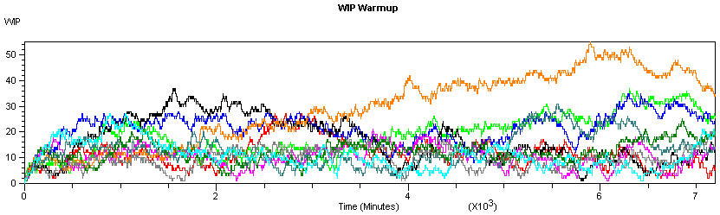
Warm Up and Run Length (cont’d.)
In Output Analyzer
  New data group, Add the file Total WIP History.dat
  Graph/Plot or
  Add Total WIP History.dat, Replications = All, enter Title, axis labels
  No apparent explosion
  Warm-up about 2000 min.; round up to 2 days (2880 min.)

Slide 35
Truncated Replications
If you can identify appropriate warm-up and run-length times, just make replications as for terminating simulations
  Only difference: Specify Warm-up Period in Run/Setup/Replication Parameters
  Proceed with confidence intervals, comparisons, all statistical analysis as in terminating case
Model 6-4: modify Model 6-3 (10 replications)
  Warm-Up period = 2 Days
  Stick with 10 replications
  Delete Output File in Statistic module

Slide 36
Truncated Replications (cont’d.)
Get cross-replications 95% confidence-interval Half Widths in Reports
  For average Total WIP, got 16.39 ± 6.51
  Without the Warm-up, this was 15.35 ± 4.42
  To sharpen the comparison of the effect of the Warm-up, did 100 (rather than 10) replications with and without it:
    With Warm-up: 15.45 ± 1.18
    Without Warm-up: 14.42 ± 0.86
  Half Widths with Warm-up are larger since each replication is based on the last 3 days, not all 5 days
Smaller confidence intervals? Have choice:
  More replications, same length
  Same number of replications, each one longer

Slide 37
Batching in a Single Run
If model warms up very slowly, truncated replications can be costly
  Have to “pay” warm-up on each replication
Alternative: Just one R E A L L Y long run
  Only have to “pay” warm-up once
  Problem: Have only one “replication” and you need more than that to form a variance estimate (the basic quantity needed for statistical analysis)
    Big no-no: Use the individual points within the run as “data” for variance estimate
    Usually correlated (not indep.), variance estimate biased

Slide 38
Batching in a Single Run (cont’d.)
Break each output record from the run into a few large batches
  Tally (discrete-time) outputs: Observation-based
  Time-Persistent (continuous-time): Time-based
Take averages over batches as “basic” statistics for estimation: Batch means
  Tally outputs: Simple arithmetic averages
  Time-Persistent: Continuous-time averages
Treat batch means as IID
  Key: batch size for low correlation (details in text)
  Still might want to truncate (once, time-based)

Slide 39
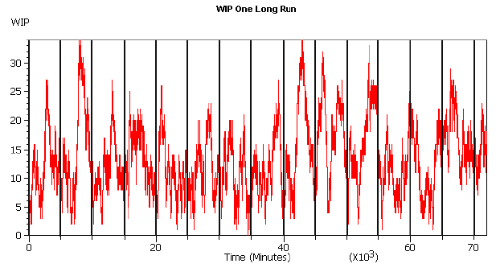
Batching in a Single Run (cont’d.)
Modify Model 6-4 into Model 6-5
  One replication of 50 days (about the same effort as 10 replications of 5 days each)
  A single 2-day Warm-up Period
  Statistic module, save WIP data once again for plot
How to choose batch size?
Equivalently, how to choose the number of batches for a fixed run length?
Want batches big enough so that batch means appear uncorrelated.

Slide 40
Batching in a Single Run (cont’d.)
Arena will automatically attempt to form 95% confidence intervals on steady-state output measures via batch means from within each single replication
  “Half Width” column in reports from one replication
    Category Overview if you just have one replication
    Category by Replication report if you have multiple replications
  Ignore if you’re doing a terminating simulation
  Uses internal rules for batch sizes (details in text)
  Won’t report anything if your run is not long enough
    “(Insufficient)” if you don’t have the minimum amount of data Arena requires even to form a c.i.
    “(Correlated)” if you don’t have enough data to form nearly-uncorrelated batch means, required to be safe

Slide 41
Batching in a Single Run (cont’d.)
Results from Model 6-5:
  Category Overview report, average total WIP: 13.64 ± 1.38
  Half Width considerably smaller than for truncated replications (10 replications, 5 days each, 2-day Warm-ups)
    Here we spend only a total of 2 days warming up, and with truncated replications we spent 10 × 2 = 20 days warming up
Can check batch-means half widths during run
  Arena variables THALF(Tally ID), DHALF(Dstat ID)
Can decide on your own batch sizes, form batch means and c.i.’s “by hand” with Output Analyzer
  Why? Use in statistical comparison procedures
  More information in book

Slide 42
What To Do?
Several approaches, methods for steady-state statistical analysis … many more exist
Opinion:
  Try to avoid steady-state simulation … look at goal of project
  If you really do want steady-state
    First try Warm-up, truncated replications
    If model warms up slowly, making truncated replications inefficient, consider Arena’s batch-means methods in a single long run with a single Warm-up Period at its beginning … can’t use statistical methods in PAN or OptQuest, though
Other methods, goals – references in text

